Slide 1
Predicting the Potability of Water
Using Logistic Regression, SVM, and Neural Networks
By Caleb Minard & Matthew Dudek

Slide 2
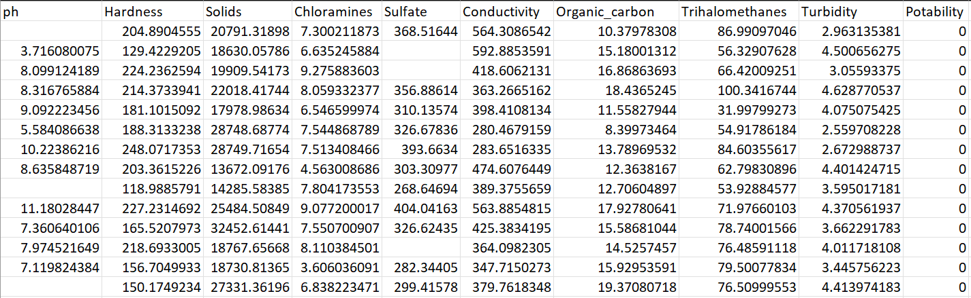
About the Data
Includes metrics regarding 3,276 different bodies of water and whether or not they are potable (from Kaggle).
The potability of water indicates whether or not it is safe to drink.
Incomplete rows were removed and the data was split into two sets based on potability before running the algorithms against the data.
811 potable sources
1,200 non-potable sources

Slide 3
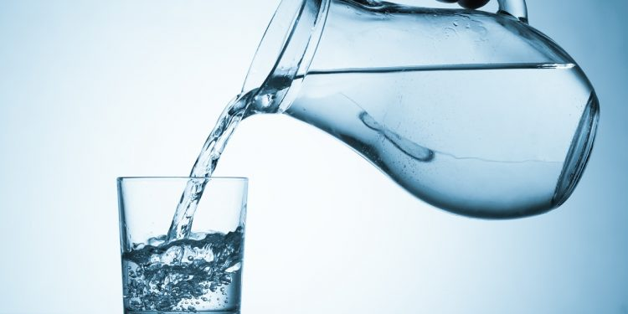
The Problem
Safe drinking water is a necessity for all human beings.
The ability to accurately predict potability based on these metrics carries a lot of value.

Slide 4
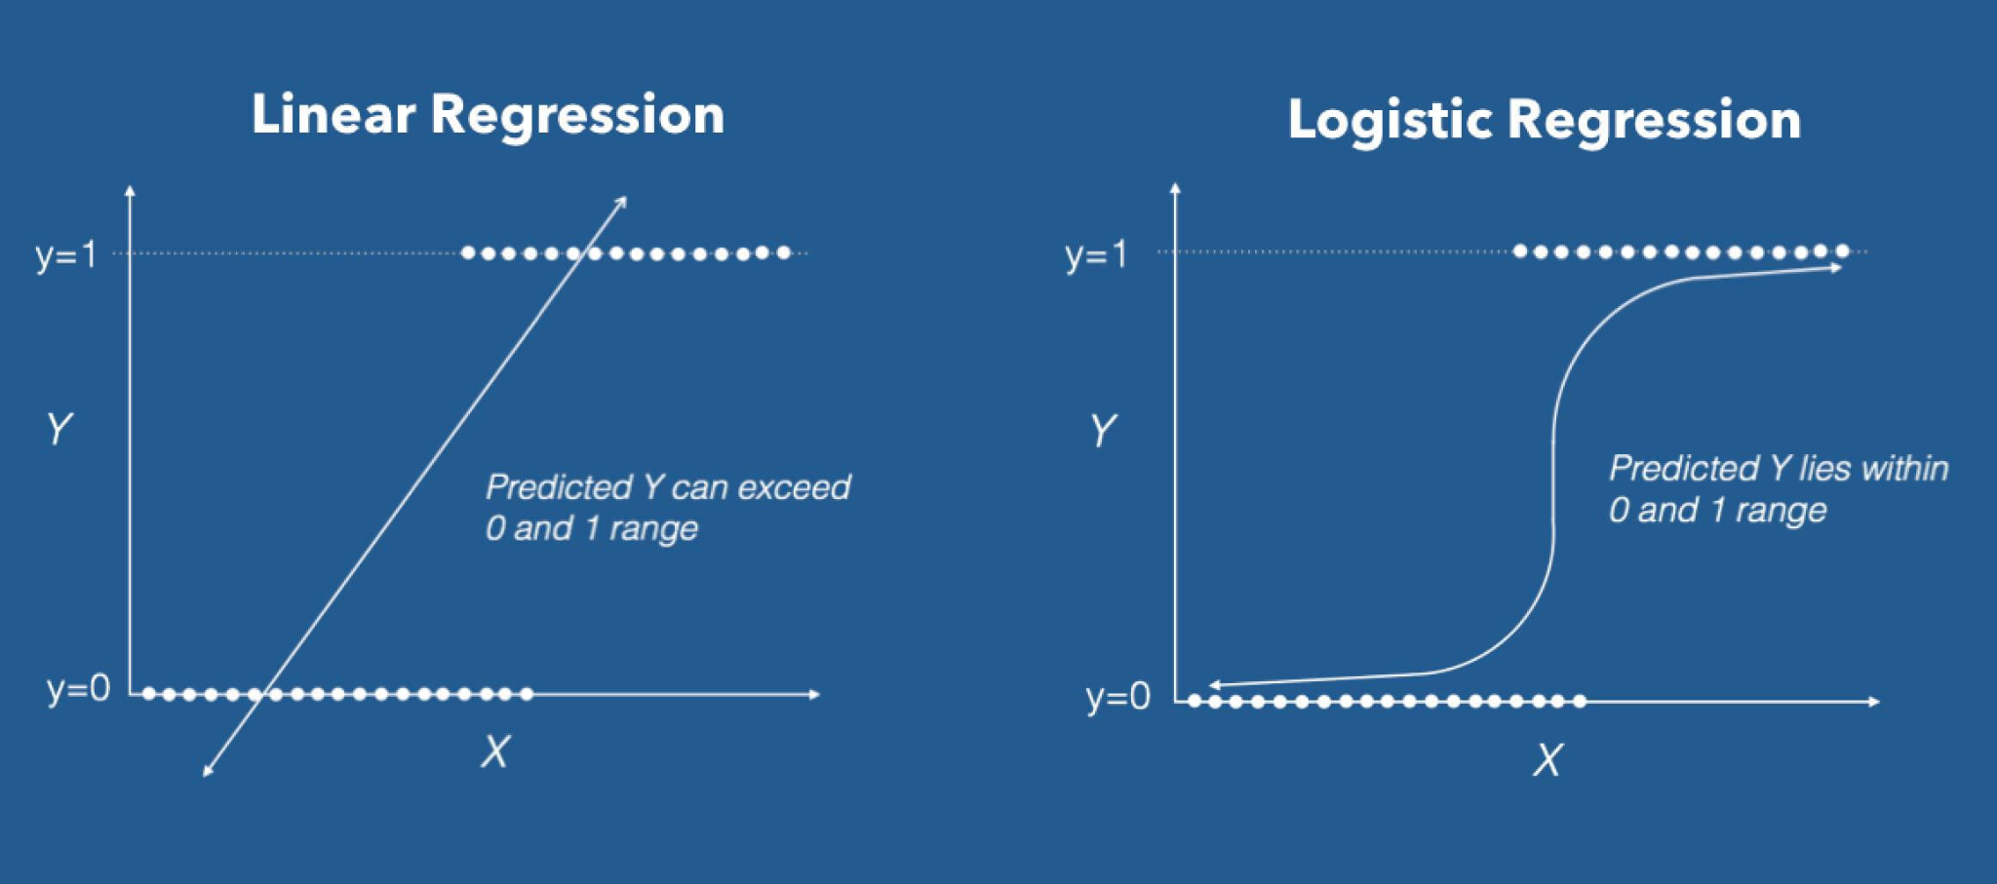
About Logistic Regression
Classification method used to make a binary prediction (such as true or false),
Predicting potability (0 or 1, 0 being non-potable and 1 being potable)
Using all attributes available in the data
Uses a sigmoid function and a maximum likelihood estimation (MLE) to relate predictor variables to the target.

Slide 5
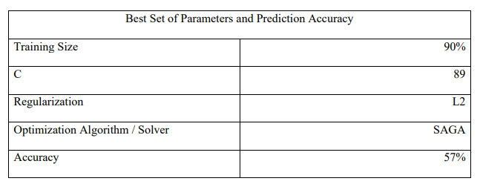
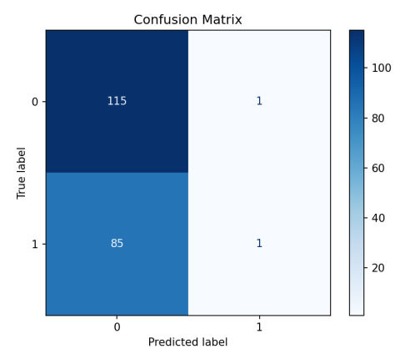
Results From Logistic Regression

Slide 6
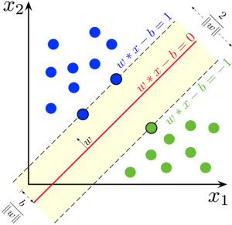
About SVM (Linear Kernel)
Attempts to split the data into parts in a 2D plane using a hyperplane to make a binary classification.
Works best with data that has a clear distinction between targets in a 2D plane.
Attempts to maximize the magnitude of the normal vector to the hyperplane to allow for more accurate prediction and less overfitting.

Slide 7
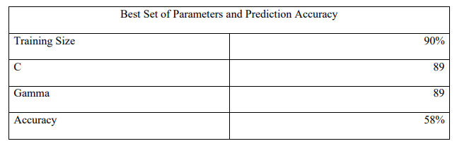
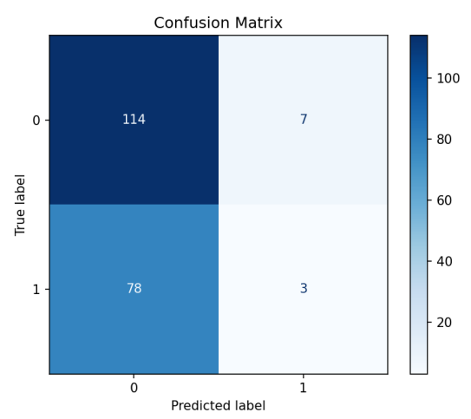
Results From SVM (Linear Kernel)

Slide 8
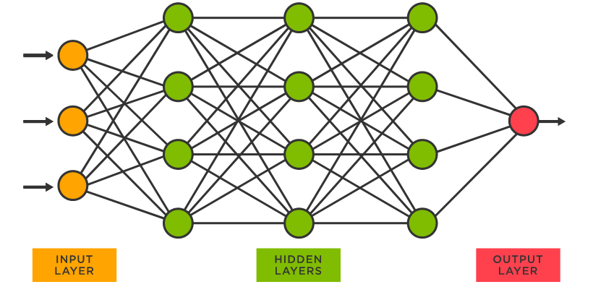
About Neural Networks
Multilayer perceptron (MLP) is an artificial feedforward neural network used for deep learning.
Trained using backpropagation to find the best weights for the input data to accurately map the data to different output classes over the course of several epochs.
Epoch - a pass forward and backward through the dataset

Slide 9
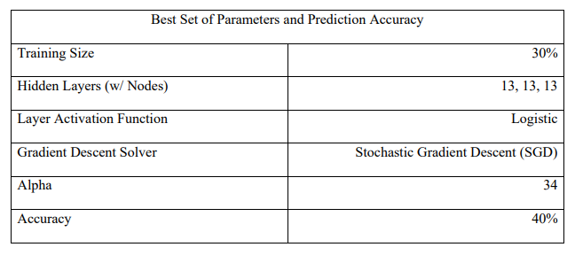
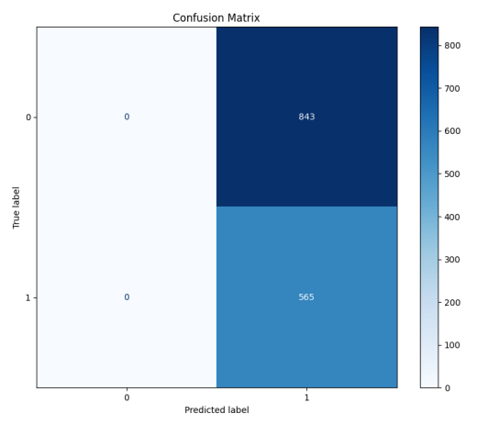
Results From Neural Networks

Slide 10
Problems Encountered
As is evident from the resulting maximum accuracies and confusion matrices, this dataset did not perform very well when put against these algorithms.
Neural nets seemed to perform the worst with only 40% accuracy, despite being the most complex algorithm.
Logistic regression and SVM seem to predict nearly every source as non-potable, while neural nets predict all as potable.
Perhaps due to the additional passes through the dataset, becoming more confused with each epoch?
Data was simply not differential enough to provide accurate prediction.
Snippet of pH for potable vs non potable:

Slide 11
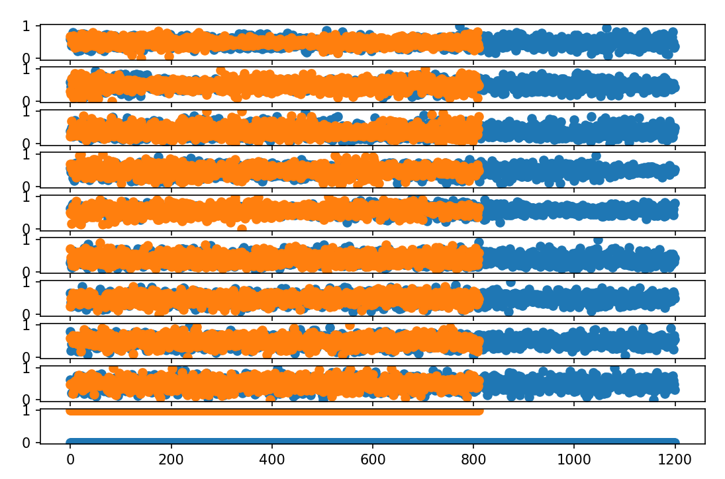
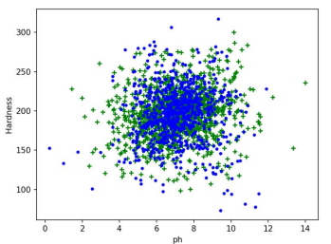
Distribution of Data

Slide 12
Conclusion & Lessons Learned
Assuming that the dataset was composed of real data…
The problem was not solved by these algorithms.
Data is too intertwined and lacking any clear separators.
Lessons learned:
Prediction scores of machine learning algorithms are heavily impacted by the parameters used.
The only way to know the “correct” parameters is through trial and error.
Sometimes the more complex algorithm performs worse than the simpler, easier to understand and implement method.
Main takeaway: choose your dataset wisely when attempting to show off prediction algorithms.

